Slide 1
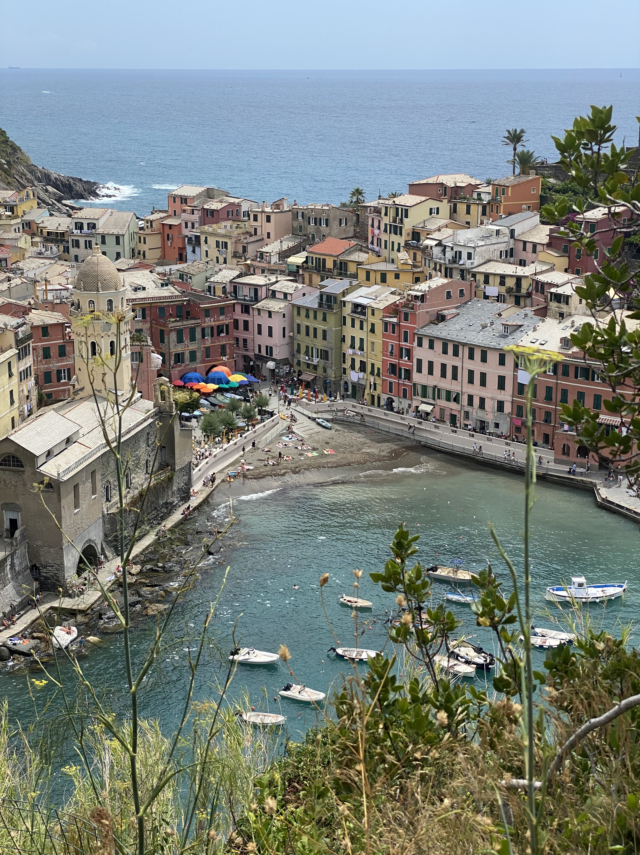
Who dis?
MKTG 300
Principles of Marketing
Raised in Altadena
Summer Shields

Slide 2
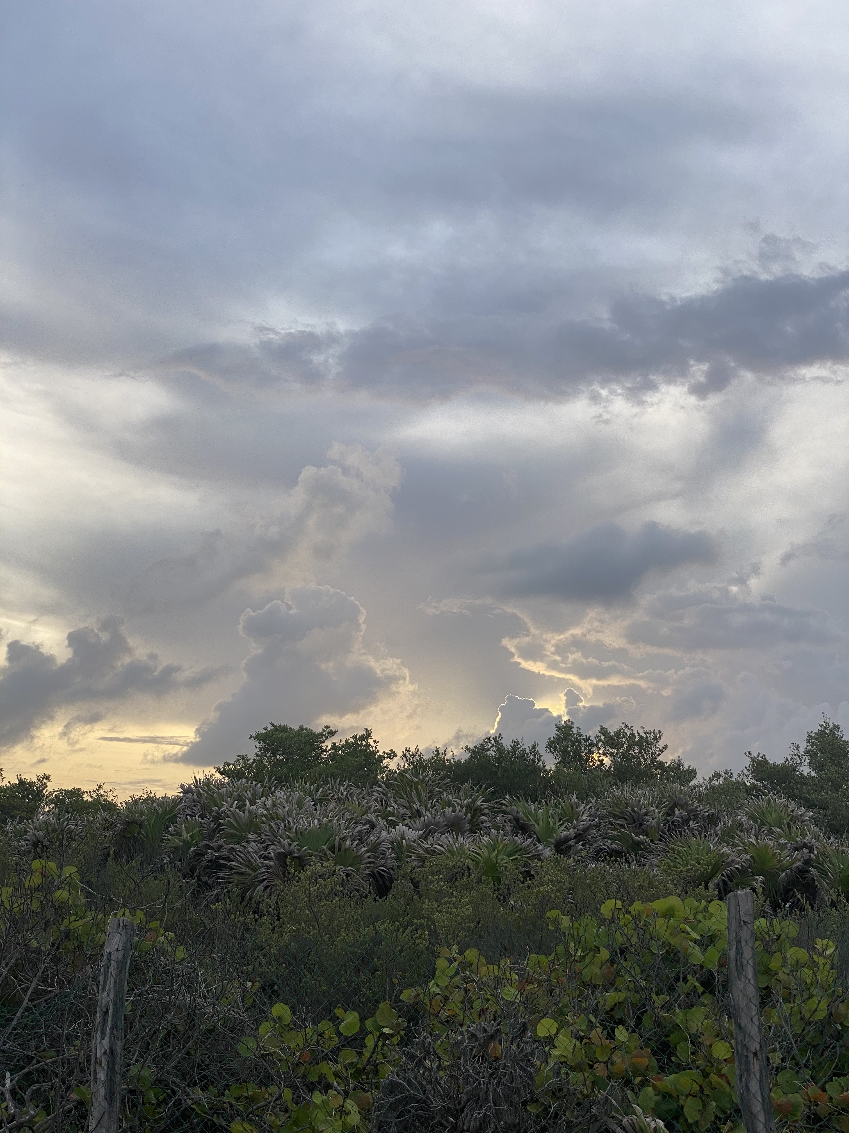
Who am I?
Assignment 1
MKTG 300

Slide 3
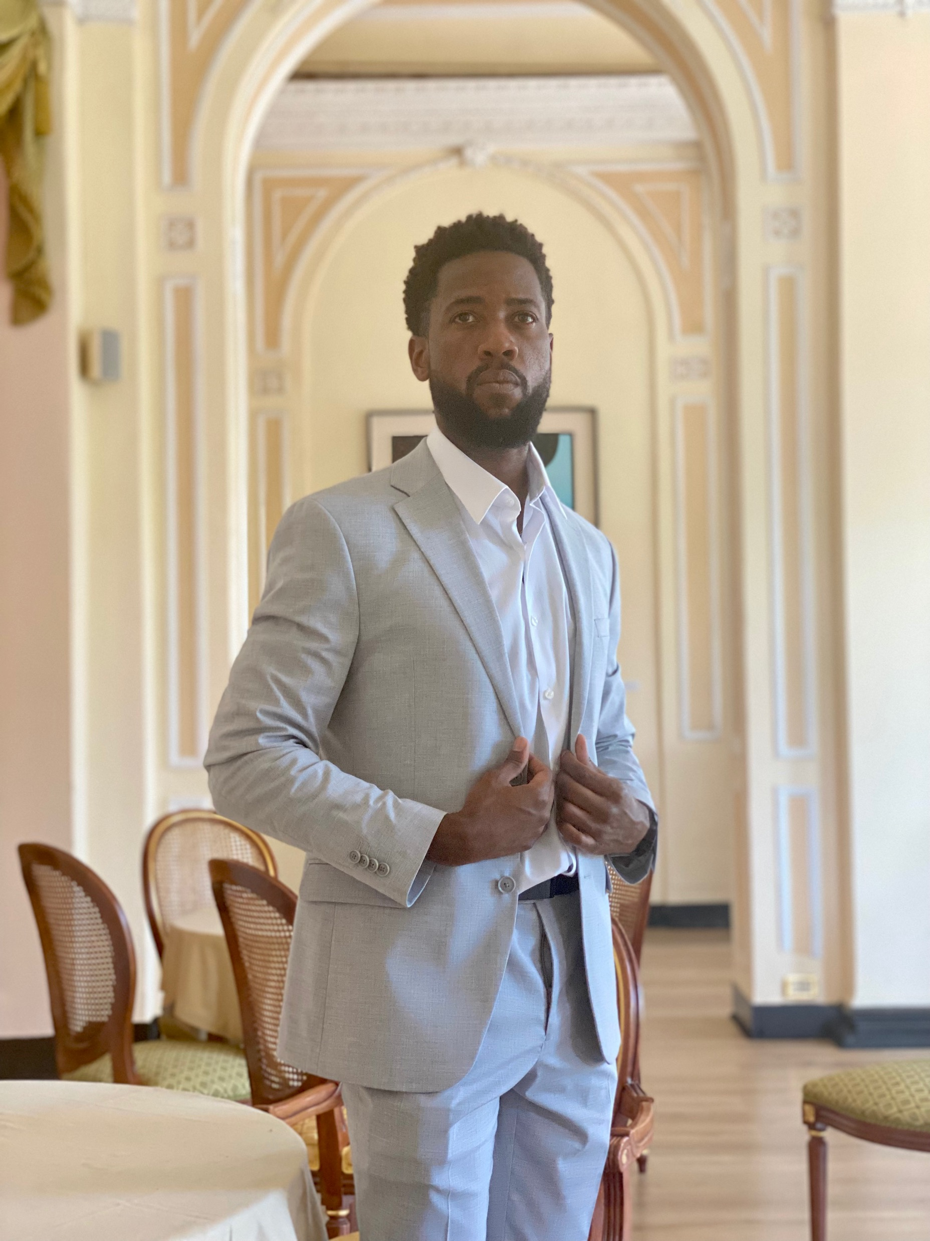
Introduction of ME
Name: Summer Shields
5 Hashtags/keywords: #driven #eccentric #laidback #fitness #traveling
Hobbies:
Road cycling, Craft beer, History, Reading, Hanging
Work experiences (former/current):
Political activist, software selling (HR, Healthcare, Telematics, Data management, etc.)
Current work schedule:
100% remote - typically 7am-4pm with travel
JUNG Typology Test Result:
INFP

Slide 4
Class expectations
What motivated you to take MKTG 300 this semester? Any specific topic you want to learn about?
It is a business requirement for my Info Sys degree, but I do software consulting/sales and it will be very nice to learn how to interface with our marketing team better, or even learn how it all works and perhaps join the marketing team some day if I get quota burnout.
What is something you’ve always wondered about marketing?
What does it take to be a competent marketer and what do recruiters look for?
What do you do all day at work?

Slide 5
COVID-19 related
What was the most challenging thing for you being a student under the “alternative mode of instruction”?
The challenges have been more social and personal than educational. For example, I’ve taken hybrid online course on the city college level, so the format I’m okay with. Now the BIG challenge will be balancing business trips with school work.
What have you learned from the current situation?
I’ve learned that life is brief and human connection cannot be overlooked or taken for granted.

